Slide 1

Selection Phase Project Synopsis Presentation
OCTOBER 2023
Dayananda Sagar College of Engineering, Bangalore, Karnataka
Department of Electronics & Communication Engineering
Project Batch No. : B-35
Subject code : 19EC7ICPR1
HeartSage: An Advanced ML Predictive Analytics System for Cardiovascular Health
USN : 1DS20EC116 (Sec-B) Name : NEERAJ JAIN
USN : 1DS20EC197 (Sec-D) Name : SMARAK MISHRA
USN : 1DS20EC214 (Sec-D) Name : SURYANSH DEVASTHALI
USN : 1DS20EC215 (Sec-D) Name : SURYANSH SAHA
Project Team.
Dr. Abhishek M B.
Dr Suma M R- A section,
Prof Srividya L - B section,
Prof Manasa R K- C Section,
Prof Bindu H M - D section.
Dr. Suma M R
Asst. Professor

Slide 2
Overview of the project selection phase presentation
Introduction
Literature Survey
Problem Statement
Objectives
Proposed Methodology with Block Diagrams
Implementation process (h/w - s/w)
Expected results (experimentation, simulation)
Advantages / Applications
Flow of the future works (Nov’23 – Jun’24)
References.

Slide 3

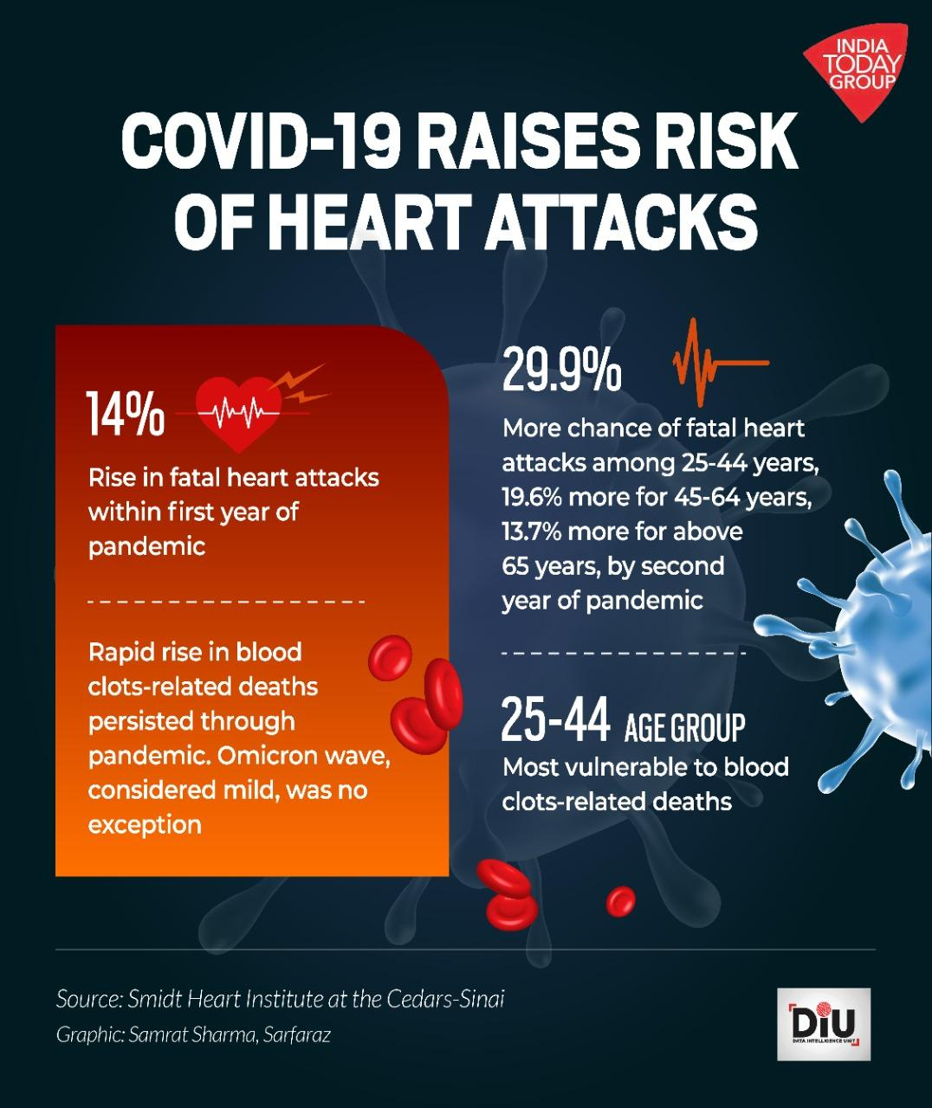
Introduction
An advanced and efficient predictive analytics system for cardiovascular health is crucial in today's healthcare landscape, where cardiovascular diseases, particularly heart attacks, pose a significant public health concern.
After the worldwide Covid-19 pandemic, people who had survived the covid infection have suffered unusual heart attacks and heart problems which can be also termed as effect of “Long Covid”
This innovative system leverages the power of predictive analytics to proactively identify individuals at a higher risk of experiencing a heart attack.

Slide 4
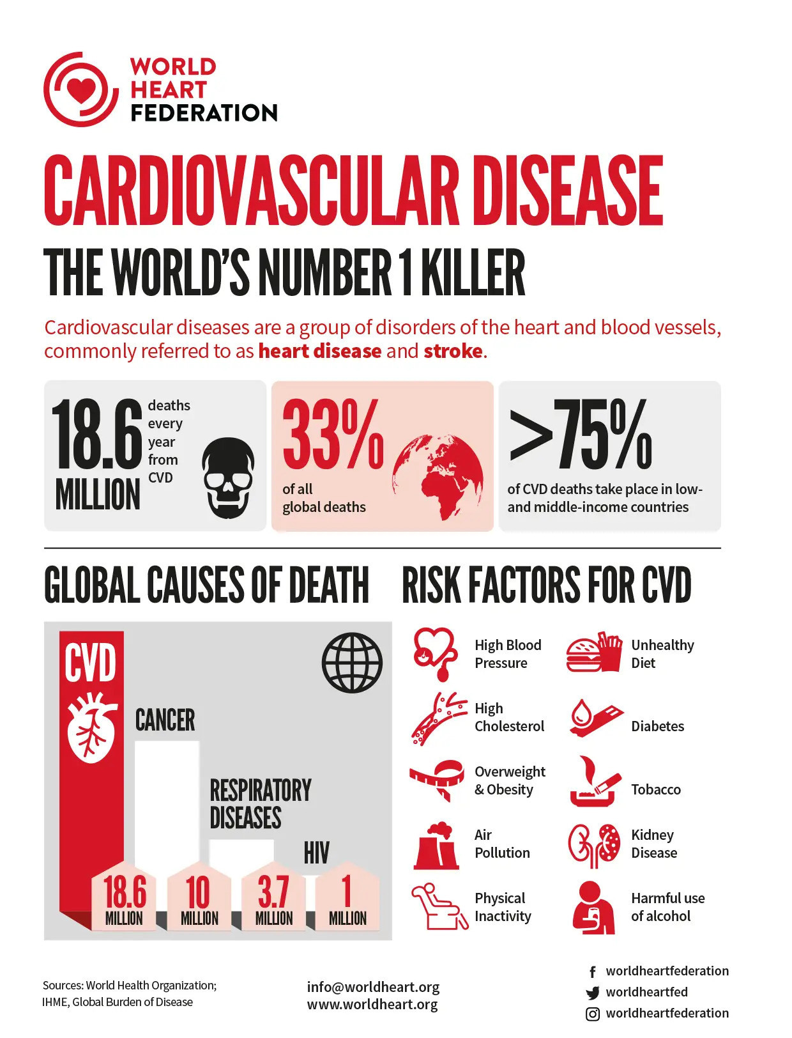
By employing cutting-edge machine learning algorithms and analyzing a diverse set of health-related data, this system aims to revolutionize preventive care and improve patient outcomes.
The primary goal of this predictive analytics system is to forecast the likelihood of a heart attack occurring in an individual within a specified time frame. By analyzing various risk factors such as age, gender, medical history, lifestyle choices, genetic predisposition, and clinical indicators, the system generates personalized risk assessments.

Slide 5
Literature Survey

Slide 6



Problem Statement
Rise In CardioVascular Diseases
Cardiovascular diseases, including heart disease and stroke, have reached epidemic proportions, becoming the leading cause of death worldwide.
Improved Self-Diagnosis
Advance self-diagnosis capabilities for individuals concerned about their cardiovascular health.
Early Detection
The early detection not only reduce the cost but also improves the quality of life.

Slide 7
Objectives

Slide 8
Proposed Methodology

Slide 9
Implementation Process

Slide 10
Expected Results

Slide 11

Advantages
Early Detection and Prevention:
The system helps in identifying individuals at high risk of a cardiovascular issue, enabling timely interventions and lifestyle changes to reduce that risk.
2. Improved Patient Outcomes:
Early intervention can significantly improve patient outcomes by reducing the severity of cardiovascular related issues and associated complications.
3 Cost-Effectiveness:
Predicting and preventing cardiovascular in advance can lead to significant cost savings for both individuals and the healthcare system by minimizing emergency care and hospitalization costs.

Slide 12


4. Personalized Medicine:
The system allows for a personalized approach to healthcare, tailoring recommendations and treatments based on an individual's specific risk factors.
5. Public Health Impact:
By identifying high-risk groups, public health initiatives can be targeted more effectively, potentially leading to a reduction in overall cardiovascular health issues in the population.
6. Data-Driven Decision Making:
Healthcare providers can make informed decisions based on the predictive insights provided by the system, enhancing the efficiency and effectiveness of their care delivery.

Slide 13
Applications
A cardiovascular health management system is a valuable tool that utilizes various algorithms, data analysis techniques, and medical information to predict the risk of an individual experiencing a heart attack. Some of its applications include:
Personalized Healthcare Plans:
Heart attack prediction systems can aid in creating personalized healthcare plans for individuals based on their risk levels. Doctors can tailor recommendations, medications, and lifestyle modifications to reduce the risk of a heart attack.
Preventive Health Screenings:
Health institutions can use these systems to identify high-risk groups within the population for targeted preventive health screenings. This can lead to better resource allocation and more effective preventive measures.

Slide 14
3. Research and Clinical Studies:
Heart attack prediction systems can contribute to medical research by providing valuable insights into risk factors and patterns. Researchers can use the data generated by these systems to enhance their understanding of heart disease and refine predictive models.
4. Health Insurance Assessment:
Health insurance companies can utilize these systems to assess the risk of potential policyholders, leading to more accurate risk assessment and appropriate premium adjustments.

Slide 15
Flowline
Aug – Sept 2023 | Team formation, Topic Selection and Approval of guide
Sept – Oct 2023 | Selection phase
Oct – Dec 2023 | Working on the project and doing test runs.
Jan – Jun 2024 | Final implementation & project demo with main-project exhibition-SEE

Slide 16
LITERATURE SURVEY
Title​ | Authors​ | Focus on​ | Drawbacks
Using PSO algorithm for producing best rules in diagnosis of heart disease. [2017] | H. Alkeshuosh, M. Z. Moghadam | A data mining model for predicting the coronary heart disease (CHD) using random forest classifier, | This model may not be able to generalize well to new or unseen data.
Backpropagation neural network for prediction of heart disease. [2013] | J. Theor | The paper uses a publicly available dataset | The model is based on a single dataset
Heart diseases prediction with data mining and neural network techniques. [2018] | B. S. S. Rathnayakc and G. U. Ganegoda | This paper compares the accuracy and error rate | The paper presents a survey of different data mining and neural network techniques
Identification of significant features and data mining techniques in predicting heart disease. [2019] | M. S. Amin, Y. K. Chiam, K. D. Varathan | ​The paper uses a dataset of 13 medical attributes and evaluates the performance of seven data mining methods | The paper does not compare its results with other existing studies on heart disease prediction
NLES: A novel lifetime extension scheme for safety-critical cyber-physical systems using SDN and NFV. [2019] | J. Wu, S. Luo, S. Wang, and H. Wang | The paper introduces a systematic virtual networking architecture enables global virtualization control and monitoring | The paper does not consider the security and privacy issues
​ | ​ | ​

Slide 17
References
https://www.researchgate.net/publication/327636316_NLES_A_Novel_Lifetime_Extension_Scheme_for_Safety-Critical_Cyber-Physical_Systems_Using_SDN_and_NFV
https://waseda.elsevierpure.com/en/publications/nles-a-novel-lifetime-extension-scheme-for-safety-critical-cyber-/fingerprints/
https://www.researchgate.net/publication/329120162_Identification_of_significant_features_and_data_mining_techniques_in_predicting_heart_disease
https://www.researchgate.net/publication/329496284_Heart_Diseases_Prediction_with_Data_Mining_and_Neural_Network_Techniques
https://www.researchgate.net/publication/288871481_Heart_Diseases_Diagnosis_Using_Neural_Networks_Arbitration

Slide 18


